Slide 1
How to create a new repository in github

Slide 2

First click

Slide 3
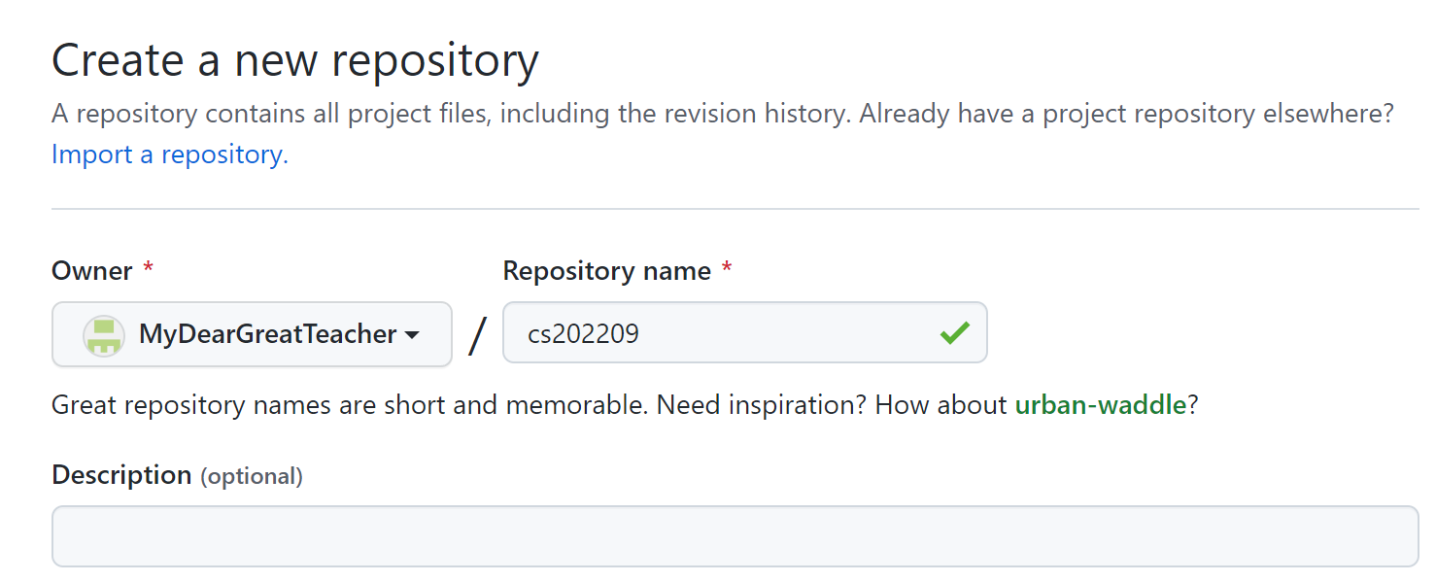
second

Slide 4
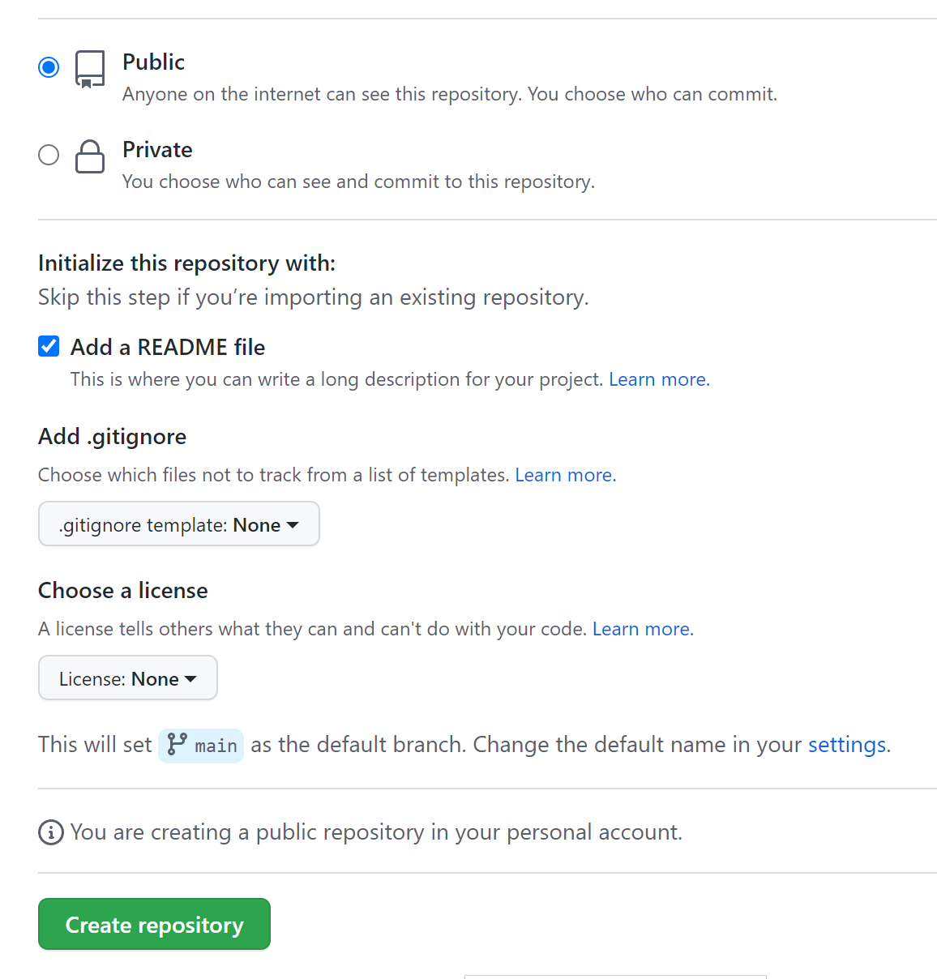
Third
①
②
③

Slide 5
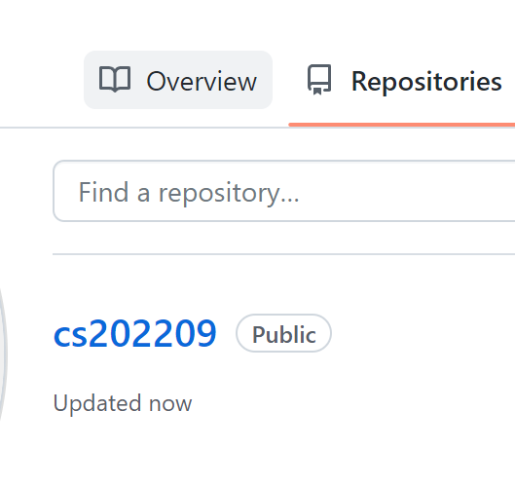
A repository is created by you

Slide 6
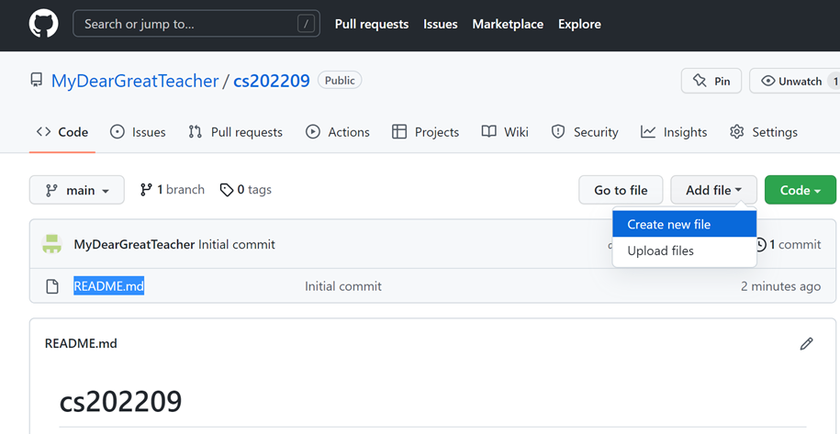
Markdown
language

Slide 7
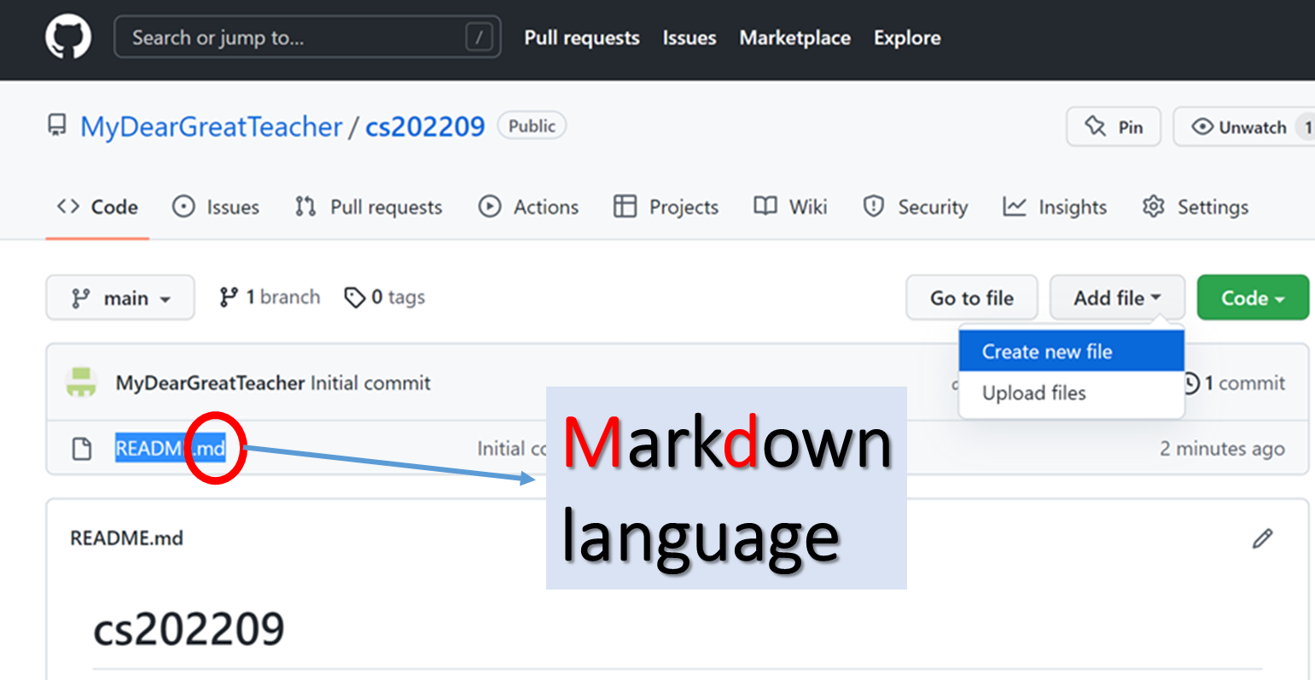
Want to create a new file myPYTHON_0921.md

Slide 8
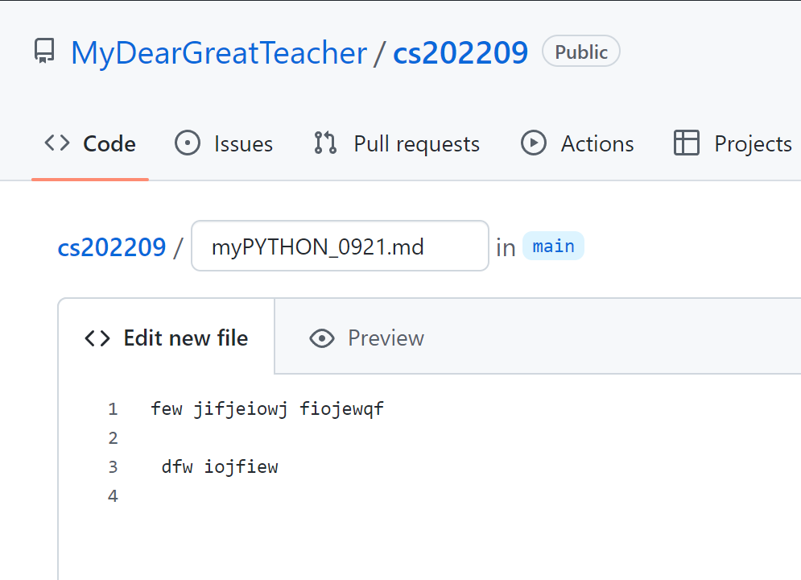
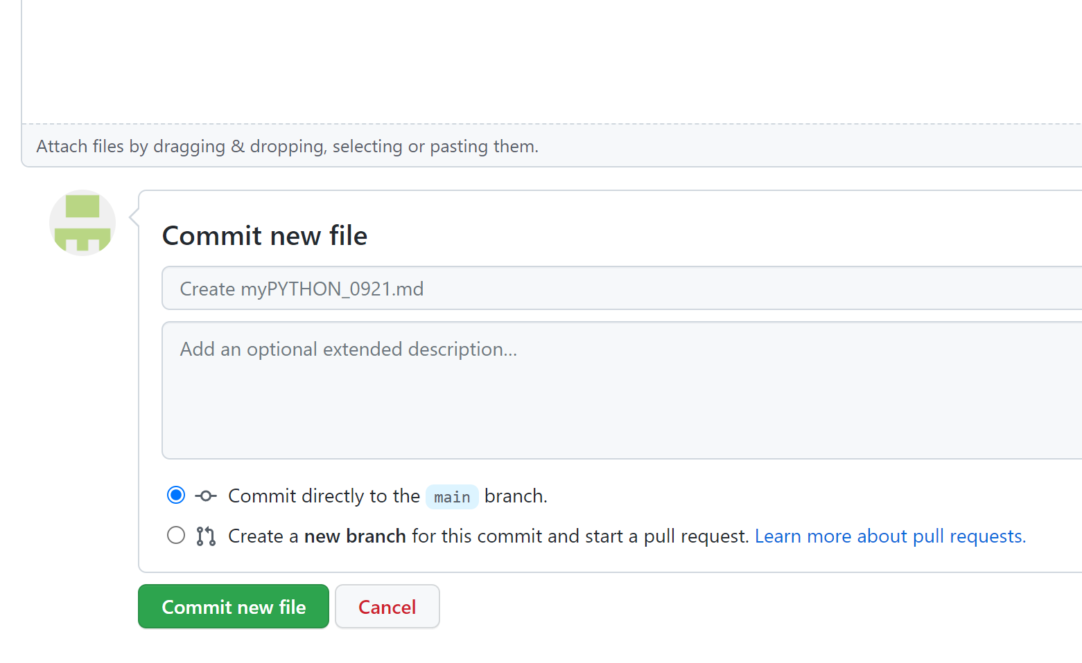

Slide 9
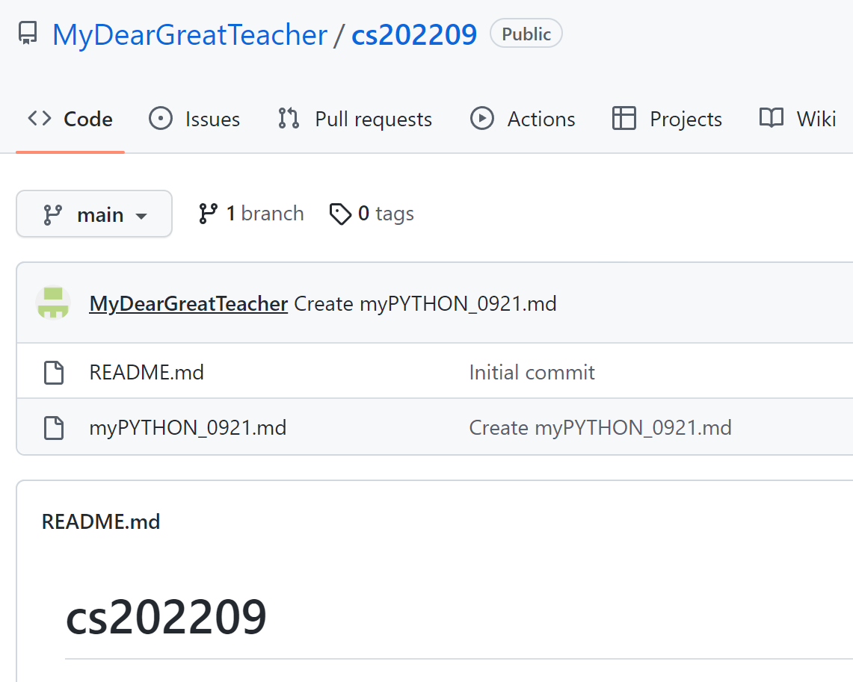

Slide 10
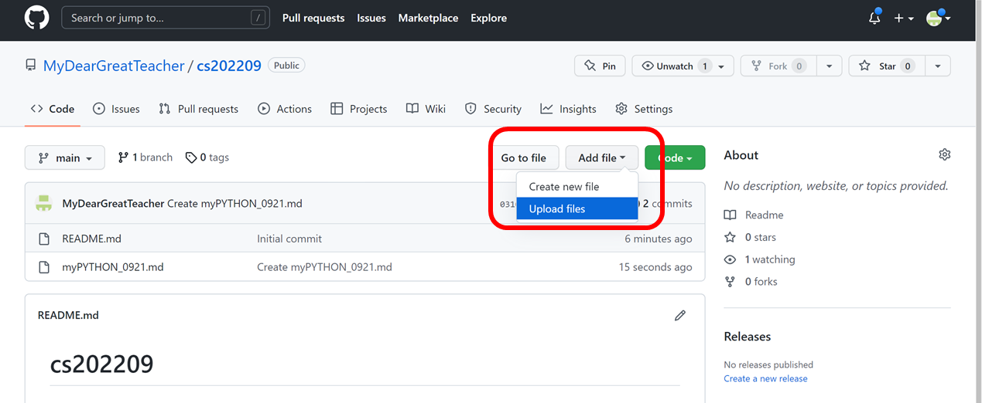
How to put my file(ppt, word, XXX.py,YYY.ipynb) to github?

Slide 11
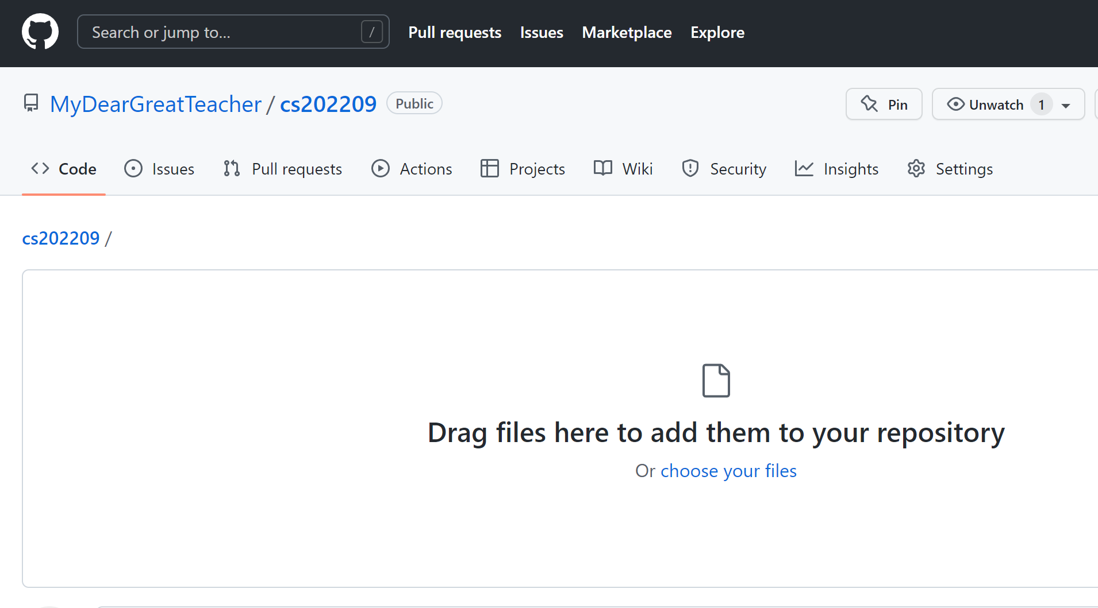

Slide 12
